Slide 1
The Power of Public Speaking
Soft Skills
Notes:
Instructor:
Read through the whole lesson (including all the notes) before the day of class
Make note of and gather any supplies you need to bring
Prepare examples, stories
Think through how much time you want to spend on individual activities; make notes
Be sure to allow time to announce the assignment at the end
Overview:
Intro (slides 1-5): 4-6 minutes
ACME: 40-45 minutes
Wrap-up: 1-2 minutes
Total: 45-53 minutes

Slide 2
Prepare
Students are going to practice public speaking during class. One of the class activities will be that the students gather in the center of the room and, facing outward, simultaneously deliver their speeches to the walls.
To prepare students for this, grab a dozen pieces of paper, draw faces on each one, and post (i.e., tape or otherwise attach) them around the room at eye level. This will give the students an unofficial audience to practice with.

Slide 3
Outcomes
Fully recognize the power that public speaking has.
Learn key elements of public speaking
Identify public speaking best practices.
Apply said practices with an impromptu speech.
Establish improvement plan.

Slide 4
The Power of Public Speaking
ACME Seminar

Slide 5
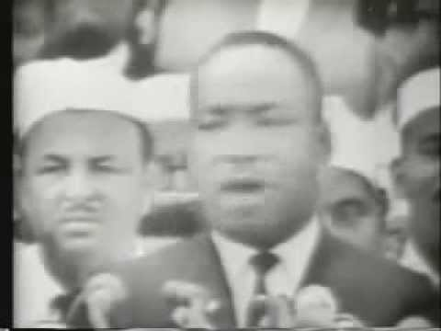
Notes:
Play from 0:17 – 2:23
Play video immediately upon beginning class, without any explanation.

Slide 6
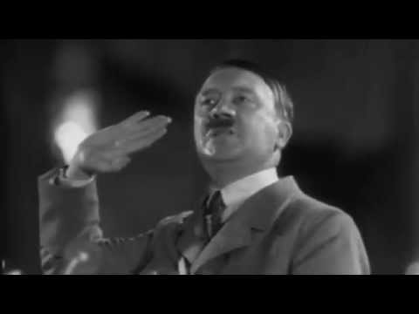
Notes:
Play from 0:05 – 2:36
Play this video immediately following the last, with no explanation.

Slide 7
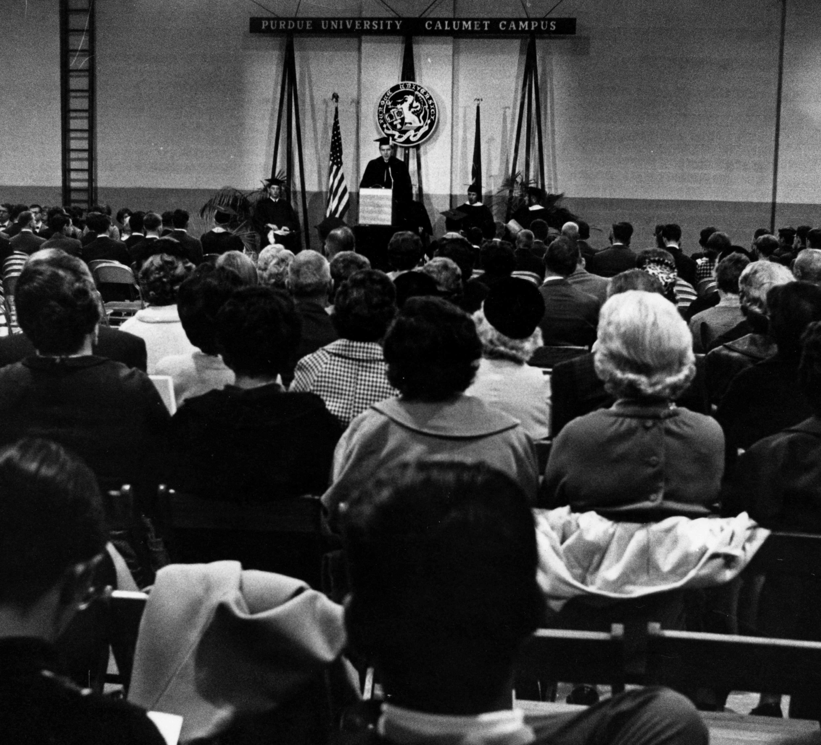
Reflect
What did you see? Feel?
What was different between the two? Similar?

Slide 8
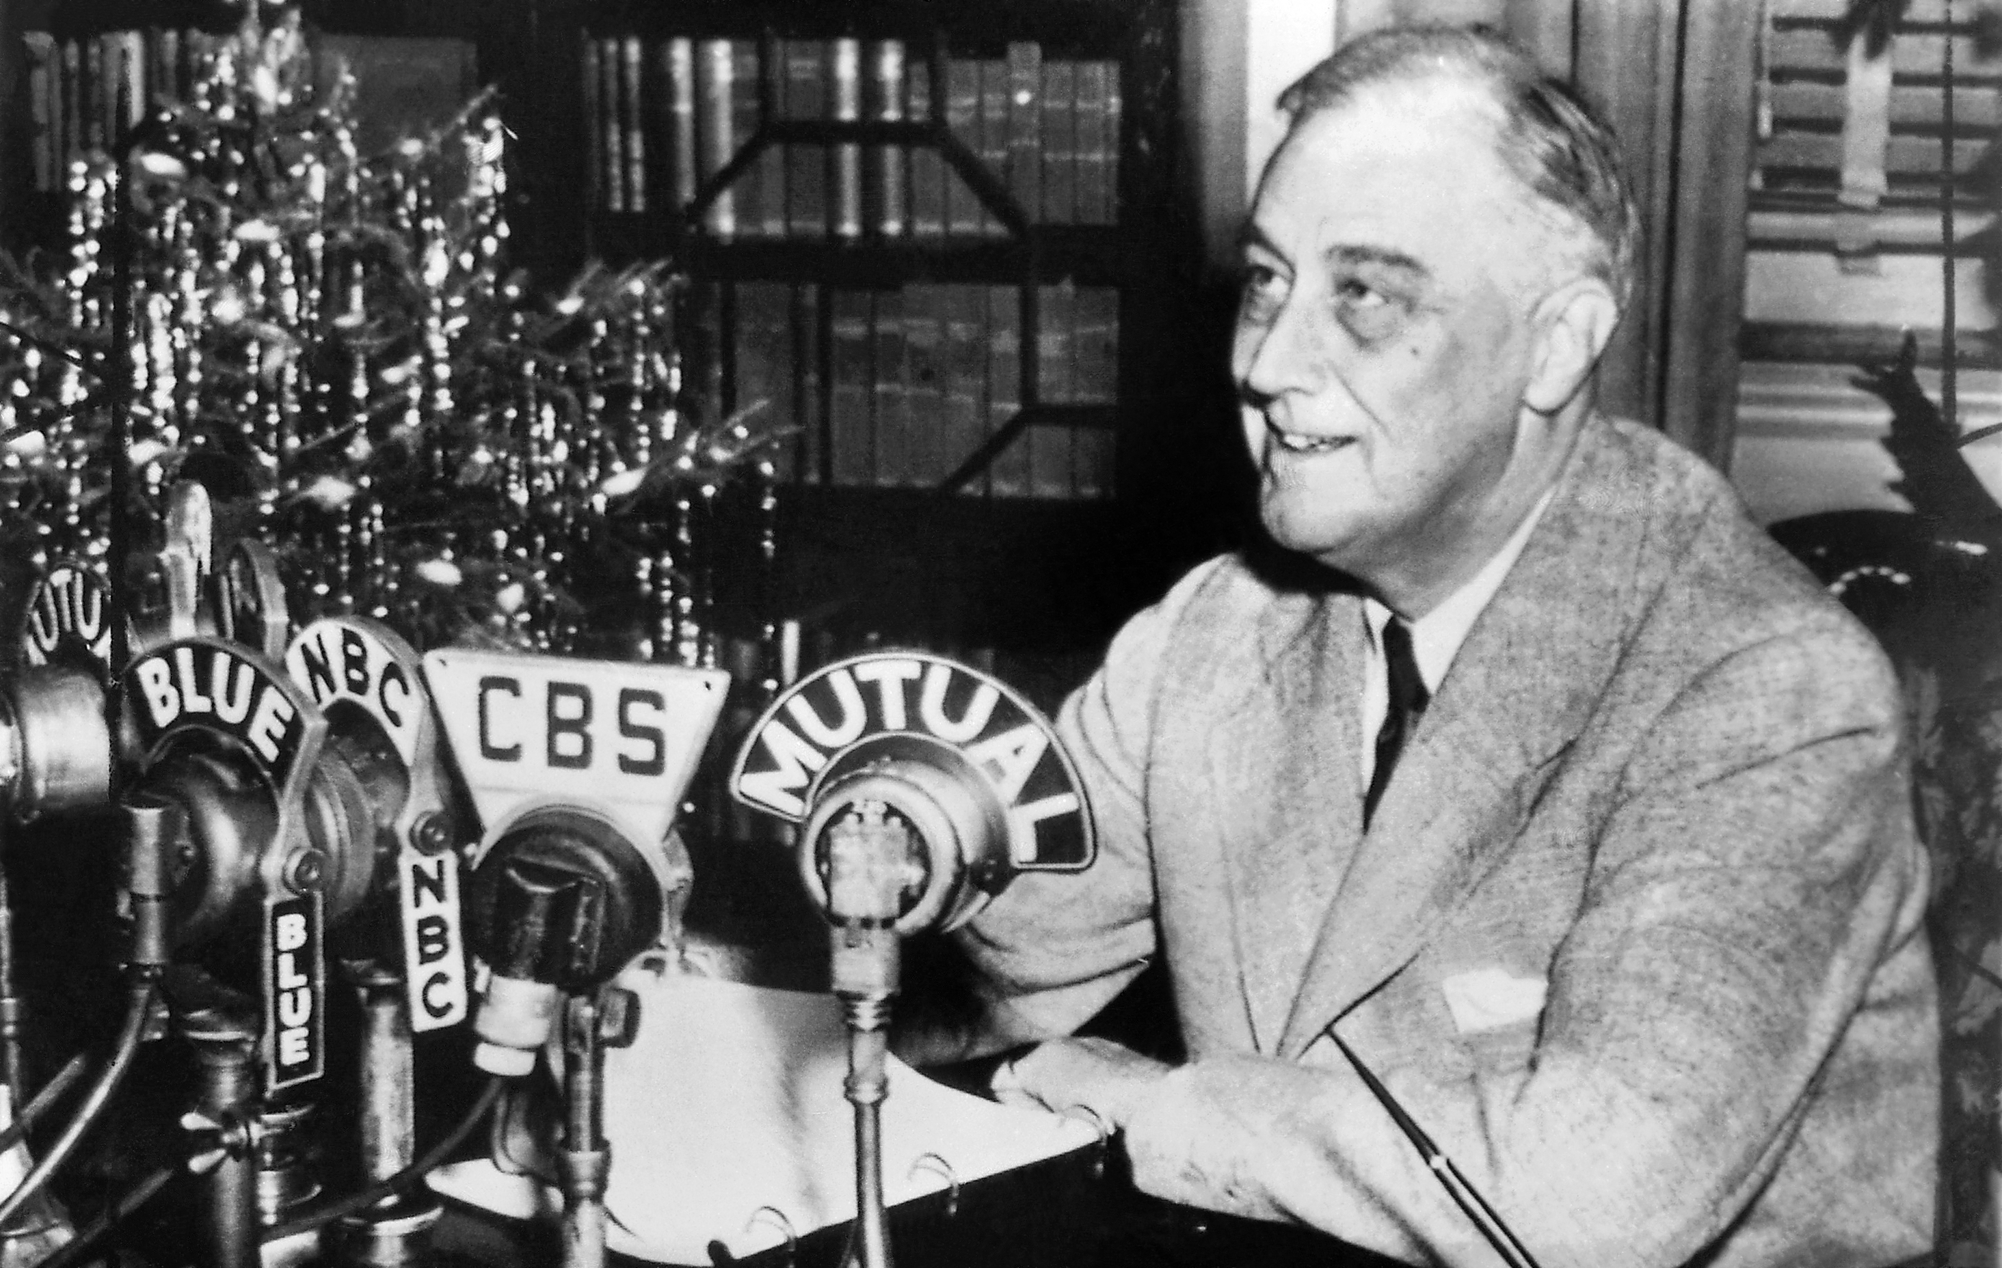
The power of public speaking is overwhelming.
Nations bend to those who eloquently command them.
Notes:
Read quickly through this slide, then move to the next

Slide 9
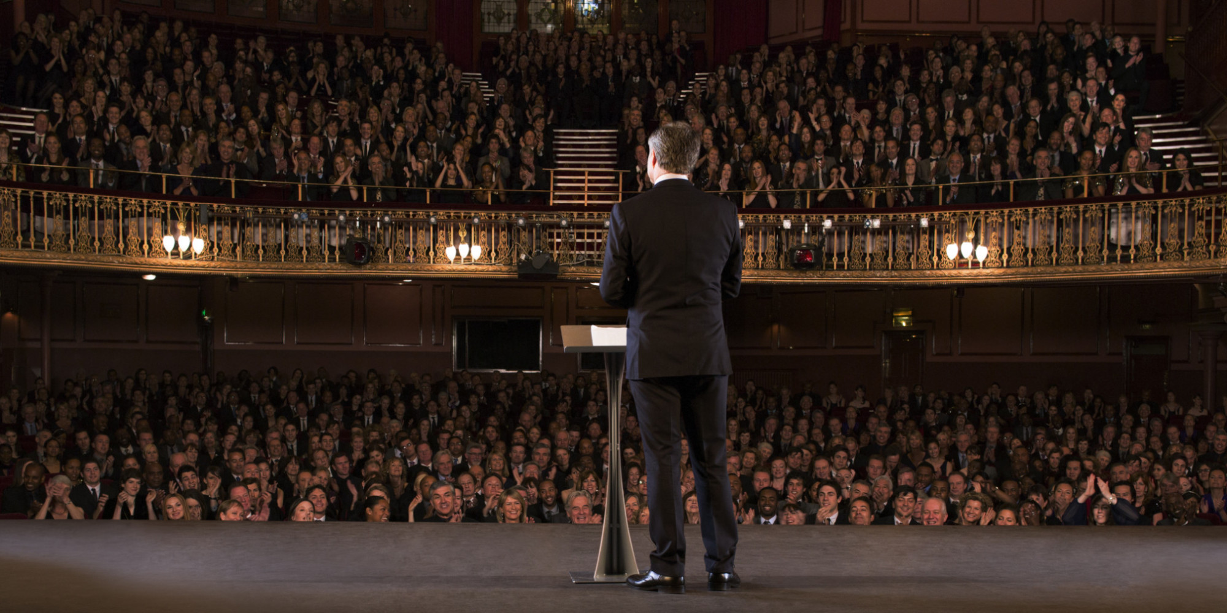
On a scale of 1-5 (1=worst, 5=best), how do you rate your public speaking abilities?
Notes:
Poll – ask students for their self-appraisal of their public speaking abilities.
Ask for a raise of hands of those who rate themselves at least 1; then go up to 2, and have only those who rate themselves at a 2 keep their hands raised; repeat until 5.
Identify those who rate themselves as the top public speakers in the class.

Slide 10
Elements of Public Speaking
ACME Seminar

Slide 11

1. Prepare
Review all materials beforehand.
Know your audience inside and out.
Notes:
Go quickly through these slides – they’ll get the principles as we move along

Slide 12
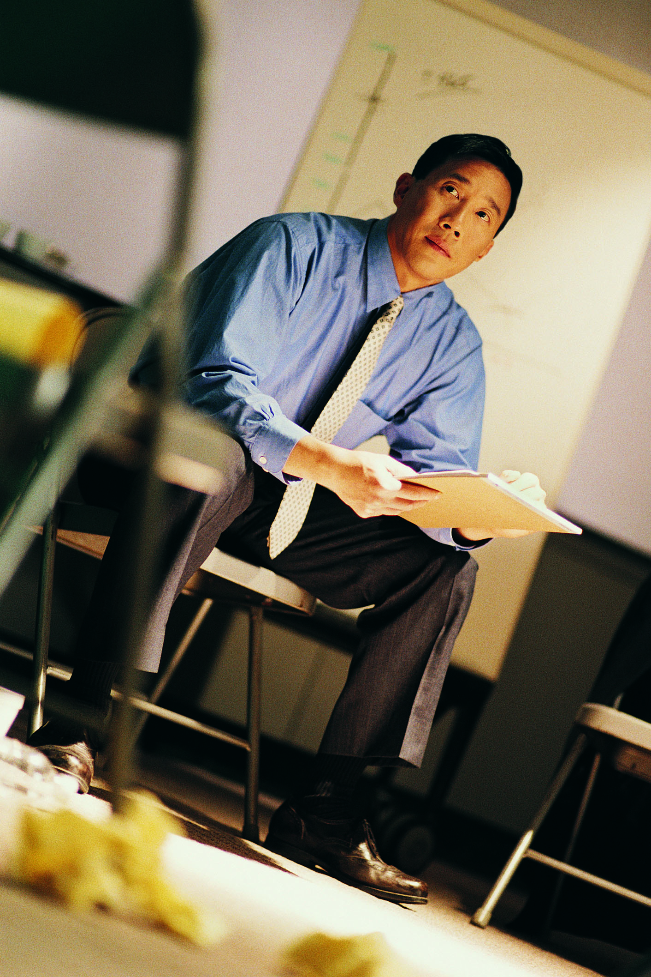
2. Perfect
Practice what needs practicing, review, practice again.
Perfect your product.
Notes:
Go quickly through these slides – they’ll get the principles as we move along

Slide 13

3. Present
Be confident in your product.
Create a memorable experience for your listeners
Notes:
Go quickly through these slides – they’ll get the principles as we move along

Slide 14
Three P’s

Slide 15
Tips (for this seminar)
Before class
In-class
Thoroughly study and prepare with all materials
Be familiar with what you will be teaching
Know which elements of the lesson are most critical
(Opt.) Ask the facilitator or a classmate for help
Field questions, but don’t let class get devoured by comments or discussion
Focus on the learning activities (these are most important to learning)
Adapt your lesson to the audience’s needs

Slide 16
Best Practices – Public Speaking
ACME Seminar

Slide 17
Demonstration
We need a 5 people willing to volunteer to demonstrate some public speaking techniques
For those who volunteer: prepare to give an impromptu persuasive speech on your favorite food
Notes:
Ask if some of the students who rated themselves most highly in public speaking would be all right with giving demonstrations.
If you can’t get 5 people to volunteer, ask a few people if they’d be willing to do double-duty.

Slide 18
Technique #1 (Volunteer #1)
Don’t look at the audience

Slide 19
Technique #2 (Volunteer #2)
Monotone speaking

Slide 20
Technique #3 (Volunteer #3)
Poor body language

Slide 21
Technique #4 (Volunteer #4)
Sayeverythingasquicklyasyoucanandwithasfewbreathsaspossible
(not a hashtag…yet)

Slide 22
Technique #5 (Volunteer #5)
So, like, use as many, um, fillers, as possible

Slide 23

So…how was that?
Notes:
Have volunteers who shared

Slide 24
For our volunteers: time for some redemption.
Let’s see how those techniques should actually look.
Notes:
Have volunteers who shared

Slide 25
Technique #1 (Volunteer #1)
Try to look at each section of the audience (“focus changes”)
Notes:
Imagine a large clock face superimposed over the audience with the numbers (1-12) in their proper place. Try to look at each of the 12 directions throughout the course of your presentation.

Slide 26
Technique #2 (Volunteer #2)
Speak with engaging intonation

Slide 27
Technique #3 (Volunteer #3)
Confident body language

Slide 28
Technique #4 (Volunteer #4)
Speak clearly, slowly, and with appropriate pauses

Slide 29
Technique #5 (Volunteer #5)
Minimize filler words
(If you hear a filler word, make a buzzer sound) ☺

Slide 30

How different was that?
Do you think you’d be able to apply those things in your public speaking (with practice, of course)?
Notes:
Have volunteers who shared reflect

Slide 31
Which of the following do you do?
No looking vs. Eye contact with audience
Monotone vs. Strong intonation
Poor body language vs. Confident body language
Sloppy diction vs. Clear diction
Talk too fast vs. Speak slowly and clearly
Filler words (“like” or “um”) vs. Minimized filler words
Notes:
Note: Write down the following things on the whiteboard so that students can see them later on.

Slide 32
Apply – Impromptu Speech
ACME Seminar

Slide 33
Poll
If someone asked you to speak about anything, right now, what would it be?

Slide 34
Prepare
Write down that subject and a few notes that would get you started.
Examples:
“I believe that every American should have free college tuition.”
“Eating healthy and exercising regularly are the greatest ways to prevent disease.”
“Halo is the greatest console video game franchise of all time.”

Slide 35

Activity: Operation Cacophony (1/3)
Create space in the middle of the room, enabling everyone to stand in a circle facing out to the walls.
Give a speech for 60 seconds on your chosen topic, while focusing on the imaginary people around the room.
Pick one of the principles we just reviewed and apply it!
Notes:
Facilitator – keep time and help the students participate, stay on task

Slide 36

Review
How did it go?
What can you do better?
What can you improve right now?

Slide 37
Activity: Operation Cacophony (2/3)
Give your same speech, but improved.
Optional: Face a partner!
Pick another one of the principles we just reviewed and apply it!
Notes:
Facilitator – keep time and help the students participate, stay on task

Slide 38
Review
How did it go?
What can you do better?
What can you improve right now?

Slide 39
Activity: Operation Cacophony (3/3)
Give your same speech, but improved even more!
Pick a third principle we just reviewed and apply it!
Notes:
Facilitator – keep time and help the students participate, stay on task.
ONLY DO THIS IF THERE IS ENOUGH TIME. OTHERWISE, SKIP TO THE NEXT SECTION.

Slide 40
Review
How did it go?
What can you do better?
What can you improve right now?
Notes:
ONLY DO THIS IF THERE IS ENOUGH TIME. OTHERWISE, SKIP TO THE NEXT SECTION.

Slide 41
Improvement Plan
ACME Seminar

Slide 42

How will you continue to improve your public speaking abilities?

Slide 43
Identify two ways you can improve and write them down:
Where would you speak?
What do you enjoy speaking about?
What are you already good at?
Etc.

Slide 44

Take-away
The better your ability to present, the more versatile you are to your employer.

Slide 45
Outcomes
Fully recognize the power that public speaking has.
Learn key elements of public speaking
Identify public speaking best practices.
Apply said practices with an impromptu speech.
Establish improvement plan.

Slide 46
Additional resources
These are great resources – look into them!!
https://www.ted.com/talks/chris_anderson_teds_secret_to_great_public_speaking
https://www.ted.com/playlists/226/before_public_speaking
https://www.entrepreneur.com/article/239308
https://www.toastmasters.org/Resources/Public-Speaking-Tips
http://www.inc.com/ss/jeff-haden/20-public-speaking-tips-best-ted-talks
https://www.ted.com/talks/melissa_marshall_talk_nerdy_to_me

Slide 47

Content (not images or videos) copyright information:

